Slide 1
Performance Optimization for Regridder Component of Uintah based on Dynamic Analysis
Project by: Nan Xiao
Scientific Computing and Imaging Institute
School of Computing
University of Utah
Advisor: Dr. Martin Berzins, SCI, University of Utah

Slide 2
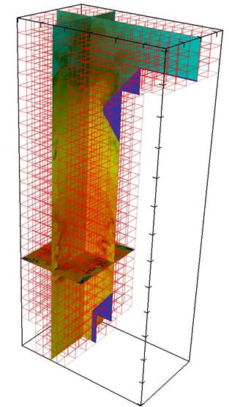
Uintah Overview
Software for the numerical modeling and simulation of accidental fires and explosions
Solving challenging fluid, solid, and fluid-structure interaction problems

Slide 3
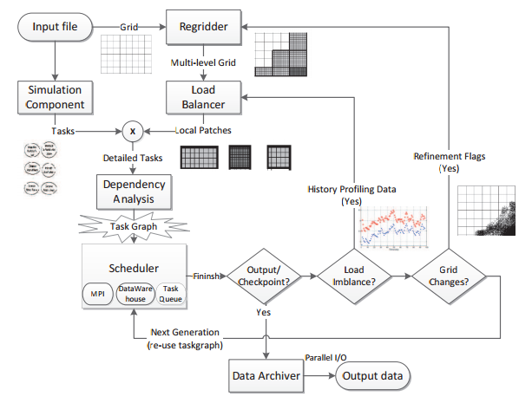
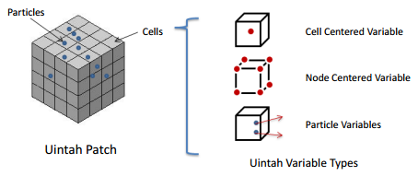
Uintah Overview

Slide 4
Regridding Process
1. Triggered Condition:
Once current timestep exceed a preset number or a refinement flag is found inside a patch
2. Main Procedures:
- Recreate Grid: Load Balancer is called to reassign patches to each processor based on Space Filling Curve (SFC) and workload estimate for each patch
- Recreate Task Graphs: Detailed task and its dependencies are created inside each patch
3. Scalability Problem
Due to frequent changes of grid

Slide 5
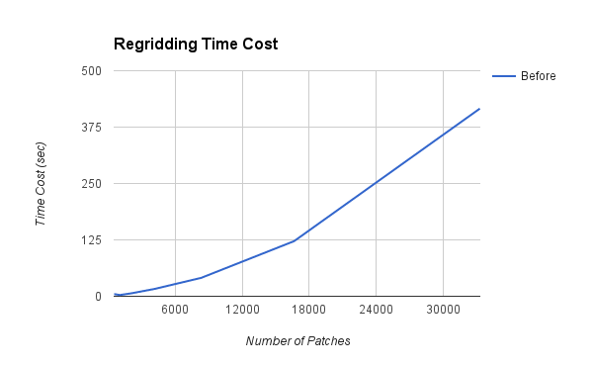
Weak Scalability for Regridding
Scalability of regridder component breaks up with a large number of patches (1 million).

Slide 6
Analysis for Regridding
1. Goal
Visualize relationships between functions
Quickly locate functions and data structures that lead to the poor scalability
2. Uintah Dynamic Profiler implemented for analysis
Generate dependencies graph of functions
Monitor memory and time cost for each function
Sample program stack

Slide 7
Uintah Dynamic Profiler
1. Set sampling Rate
2. Manually inserted timer block
3. Back tracing program stack & program break locations (first location after the end of the uninitialized data segment)
4. Generate dependencies graph and data processing

Slide 8
Uintah Dynamic Profiler
dbg/lib/libCCA Components LoadBalancers.so (Uintah::LoadBalancerCommon::createNeighborhood(HandleINS 4GridEEES5 +0x454)
dbg/lib/libCCA Components Schedulers.so (Uintah::TaskGraph::createDetailedTasks::DetailedTasks(HandleINS 4GridEEES7 +0x9e)
dbg/lib/libCCA Components Schedulers.so (Uintah::SchedulerCommon::compile+0x1da)
dbg/lib/libCCA Components SimulationController.so (Uintah::AMRSimulationController::recompile(HandleINS 4GridEEEi+0x7e2)
dbg/lib/libCCA Components SimulationController.so (Uintah::AMRSimulationController::run+0x665)
./sus(main+0x1160)
Data: Collection of Sampling Data
Result: Dependency Graph
stack = [];
for line in n do
if line 6= "===" then
stack.append(line)
else
for depth = 1 to len(stack) + 1 do
cur stack = stack[-depth:];
cur key = stack to id(cur stack);
prv key = stack to id(cur stack[1:]);
count[cur key] = count.get(cur key) + 1;
if prv key not in edge: edge[prv key] = [];
edge[prv key].append(cur key);
end
end
end

Slide 9

Uintah Dynamic Profiler
1. Time utilization rate of $cur_fun$ in $par_fun$:
$F_{tp}\left(cur_fun,par_fun\right)=\frac{cnt_{cur_fun}}{cnt_{par_fun} }$
$cnt_{fun}≈\sum_{i=1}^{n}{cnt_{calling_fun_{i}}}$
2. Time cost for each function:
$F_{t}\left(cur_fun\right)=\sum_{i=1}^{n}{F_{t}\left(par_fun_{i}\right)×F_{tp}(cur_fun, par_fun_{i})}$

Slide 10
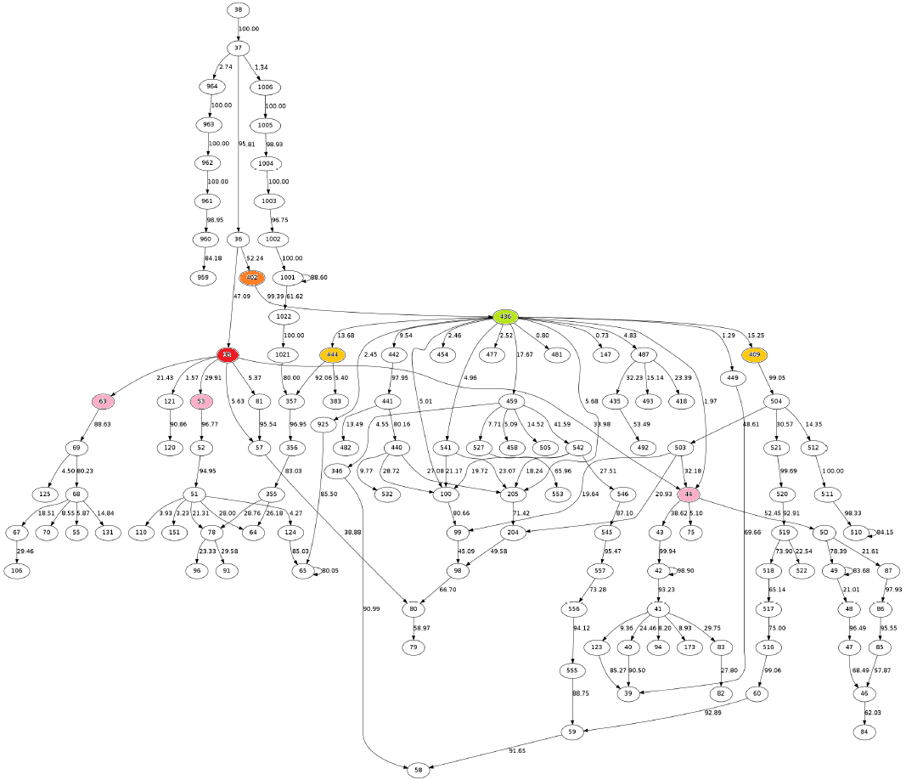
createNeighborhood (node35) : 47.09% | createDetailedDependencies (node436) : 52.24%
selectPatches (node44) : 33.98% | inNeighborhood (node444) : 13.68%
findNeighborProcessors (node63) : 21.43% | getPatchesUnderDomain (node409) : 15.25%
findNeighborPatches (node53) : 29.91%

Slide 11
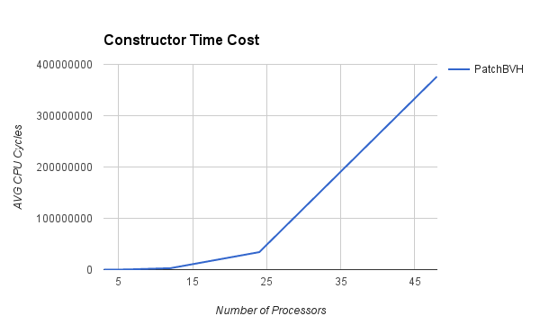
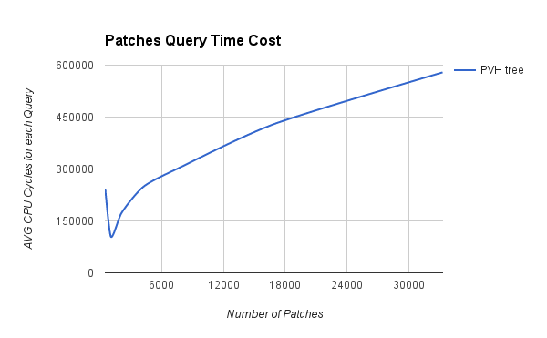
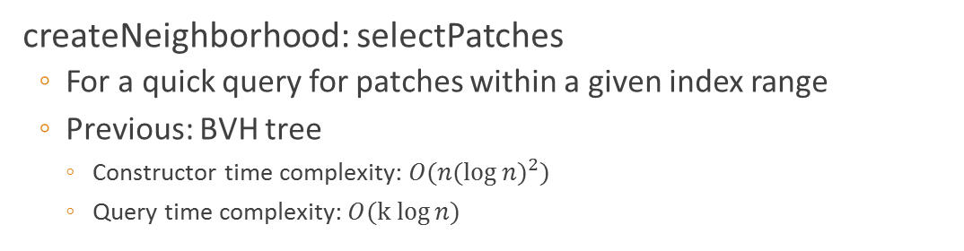
Optimization
createNeighborhood: selectPatches
For a quick query for patches within a given index range
Previous: BVH tree
Constructor time complexity: ${O(n(\log{n})}^{2})$
Query time complexity: $O(k log{n)}$
 |  |  |  |  | ●
 |  |  |  |  | ● | ●
 |  |  |  |  | ● | ● | ●
 |  |  |  |  | ● | ● | ●
 |  | ● | ●
 | ● | ● | ●
 | ● | ● | ● | ●
 | ●

Slide 12

Optimization
createNeighborhood: selectPatches
For a quick query for patches within a given index range
Current: Hash Tree
Constructor time complexity: $O(n)$
Query time complexity: $O(k\log{m})$
 |  |  |  |  | ●
 |  |  |  |  | ● | ●
 |  |  |  |  | ● | ● | ●
 |  |  |  |  | ● | ● | ●
 |  | ● | ●
 | ● | ● | ●
 | ● | ● | ● | ●
 | ●

Slide 13
Optimization
createNeighborhood: selectPatches
For a quick query for patches within a given index range
Current: Hash Tree
1 |  |  |  |  | ●
2 |  |  |  |  | ● | ●
3 |  |  |  |  | ● | ● | ●
3 |  |  |  |  | ● | ● | ●
2 |  | ● | ●
3 | ● | ● | ●
4 | ● | ● | ● | ●
1 | ●
 | 3 | 3 | 3 | 1 | 4 | 3 | 2 | 0
initialization;
create a box to enclose all patches;
generate histograms of all patches along x,y,z axis;
calculate empty ratio of current domain based on histograms;
if empty ratio less than 50% then
split current domain;
fit new boxes to each subdomain;
end

Slide 14
Optimization
createNeighborhood: selectPatches
For a quick query for patches within a given index range
Current: Hash Tree
1 |  |  |  |  | ●
2 |  |  |  |  | ● | ●
3 |  |  |  |  | ● | ● | ●
3 |  |  |  |  | ● | ● | ●
2 |  | ● | ●
3 | ● | ● | ●
4 | ● | ● | ● | ●
1 | ●
 | 3 | 3 | 3 | 1 | 4 | 3 | 2 | 0
initialization;
create a box to enclose all patches;
generate histograms of all patches along x,y,z axis;
calculate empty ratio of current domain based on histograms;
if empty ratio less than 50% then
split current domain;
fit new boxes to each subdomain;
end

Slide 15
Optimization
createNeighborhood: selectPatches
For a quick query for patches within a given index range
Current: Hash Tree
1 |  |  |  |  | ●
2 |  |  |  |  | ● | ●
3 |  |  |  |  | ● | ● | ●
3 |  |  |  |  | ● | ● | ●
2 |  | ● | ●
3 | ● | ● | ●
4 | ● | ● | ● | ●
1 | ●
 | 3 | 3 | 3 | 1 | 4 | 3 | 2 | 0
initialization;
create a box to enclose all patches;
generate histograms of all patches along x,y,z axis;
calculate empty ratio of current domain based on histograms;
if empty ratio less than 50% then
split current domain;
fit new boxes to each subdomain;
end

Slide 16
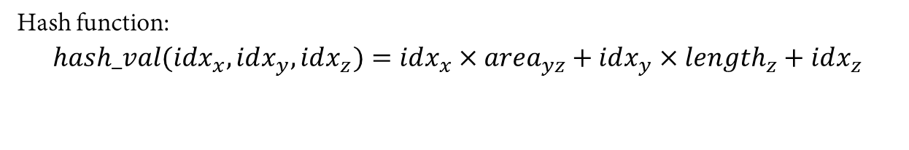
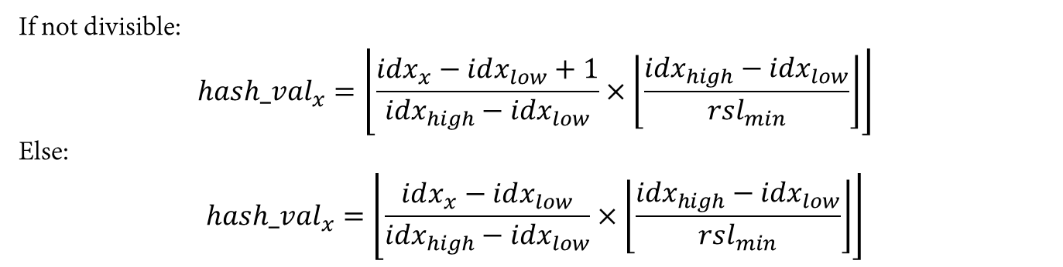
Optimization
createNeighborhood: selectPatches
For a quick query for patches within a given index range
Current: Hash Tree
Hash function:
$$hash_val(idx_{x}, idx_{y},idx_{z})=idx_{x}×{area}_{yz}+idx_{y}×length_{z}+idx_{z}$$
Idx: | [0,3) | [3,6) | [6,10)
hash_val: | 0 | 1 | 2
If not divisible:
$${hash_val}_{x}=\left\lfloor \frac{idx_{x}−idx_{low}+1}{{idx}_{high}−{idx}_{low}}×\left\lfloor \frac{{idx}_{high}−{idx}_{low}}{{rsl}_{min}}\right\rfloor \right\rfloor$$
Else:
$${hash_val}_{x}=\left\lfloor \frac{idx_{x}−idx_{low}}{{idx}_{high}−{idx}_{low}}×\left\lfloor \frac{{idx}_{high}−{idx}_{low}}{{rsl}_{min}}\right\rfloor \right\rfloor$$

Slide 17
Optimization
createNeighborhood: selectPatches
For a quick query for patches within a given index range
Current: Hash Tree
1 |  |  |  |  | ●
2 |  |  |  |  | ● | ●
3 |  |  |  |  | ● | ● | ●
3 |  |  |  |  | ● | ● | ●
2 |  | ● | ●
3 | ● | ● | ●
4 | ● | ● | ● | ●
1 | ●
 | 3 | 3 | 3 | 1 | 4 | 3 | 2 | 0
Quick Indexing:
Each bucket points to the next valid bucket based on query order

Slide 18
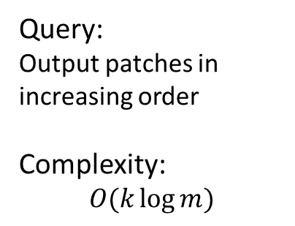
Optimization
createNeighborhood: selectPatches
For a quick query for patches within a given index range
Current: Hash Tree
Query:
Output patches in increasing order
Complexity:
$$O(k\log{m})$$
2 | 8 | …
12 | 24 | …
1
21 | 22 | …
11
20
41 | 42 | …
40

Slide 19
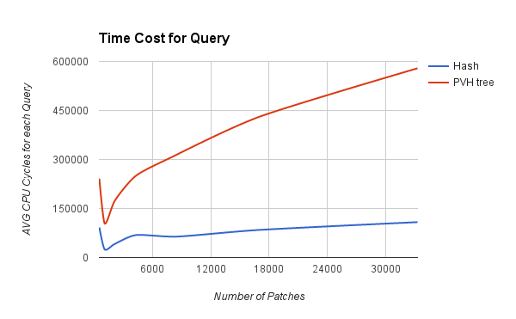
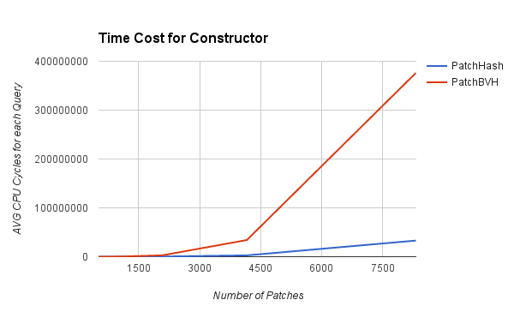
Optimization
createNeighborhood: selectPatches
For a quick query for patches within a given index range
Current: Hash Tree

Slide 20
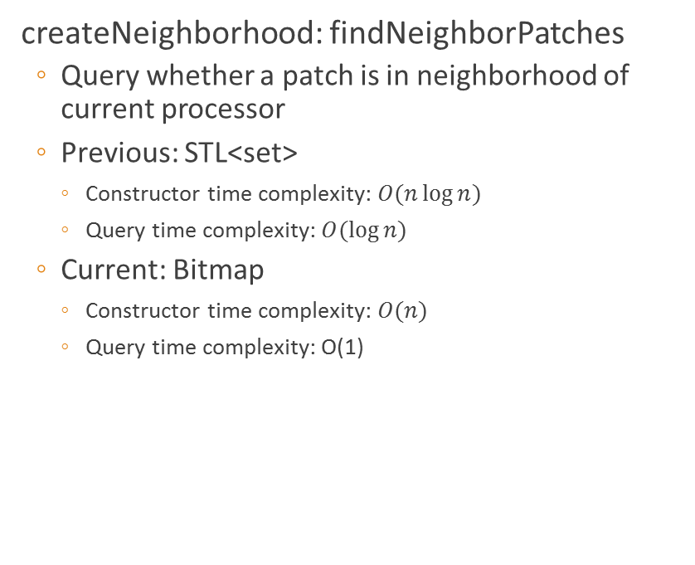
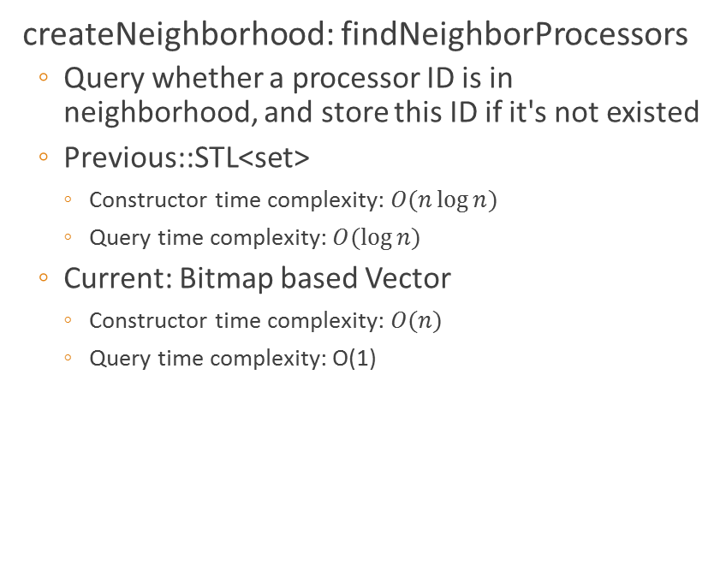
Optimization
createNeighborhood: findNeighborPatches
Query whether a patch is in neighborhood of current processor
Previous: STL<set>
Constructor time complexity: $O(n\log{n})$
Query time complexity: $O(\log{n})$
Current: Bitmap
Constructor time complexity: $O(n)$
Query time complexity: O(1)
createNeighborhood: findNeighborProcessors
Query whether a processor ID is in neighborhood, and store this ID if it's not existed
Previous::STL<set>
Constructor time complexity: $O(n\log{n})$
Query time complexity: $O(\log{n})$
Current: Bitmap based Vector
Constructor time complexity: $O(n)$
Query time complexity: O(1)

Slide 21
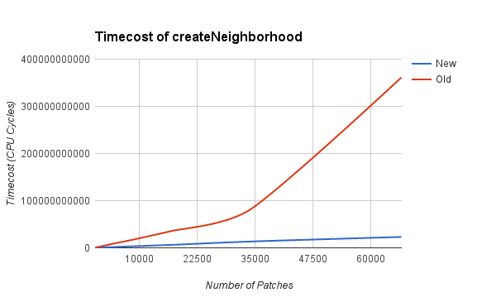
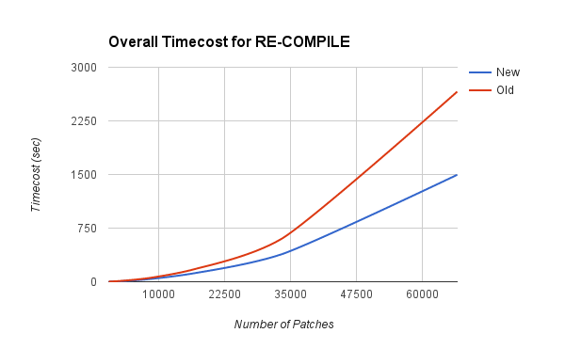
Optimization
Overall createNeighborhood and regridding performance after optimiztion

Slide 22
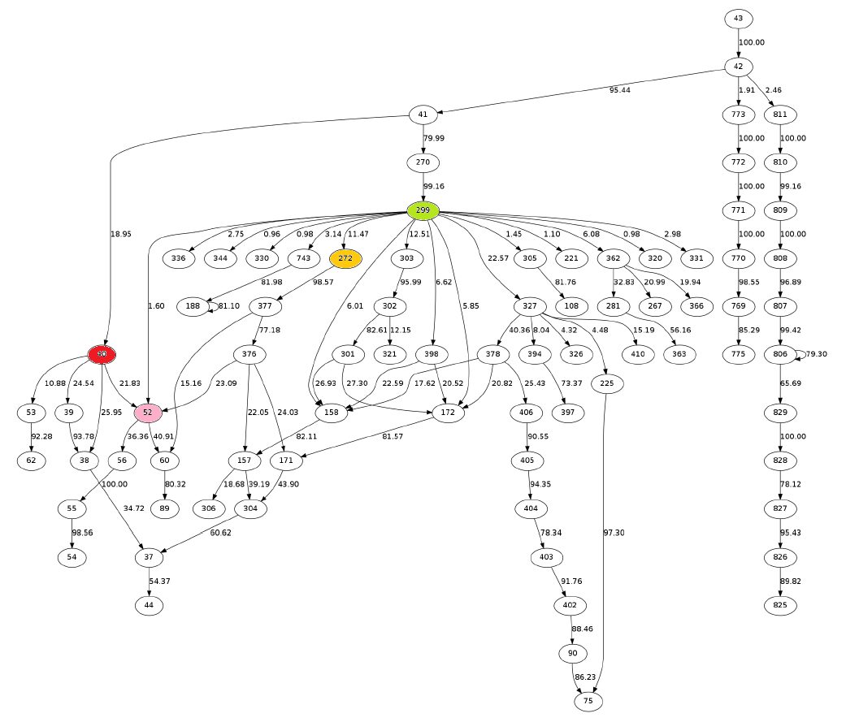
Names | createNeighborhood | selectPatches | findNeighborProcessors | findNeighborPatches | createDetailedDependencies | inNeighborhood | getPatchesUnderDomain
Old | 47.09% | 33.98% | 21.43% | 29.91% | 52.24% | 13.68% | 15.25%
New | 18.95% | 21.83% | < 1.0% | < 1.0% | 79.99% | < 1.0% | 11.47%

Slide 23
Future Work
Distributed Metadata Management
Current approach stores a copy of all patches in all levels would become intolerable with large number of patches
Compress and distribute metadata among processors and transmit them when needed

Slide 24
Questions?

